Slide 2
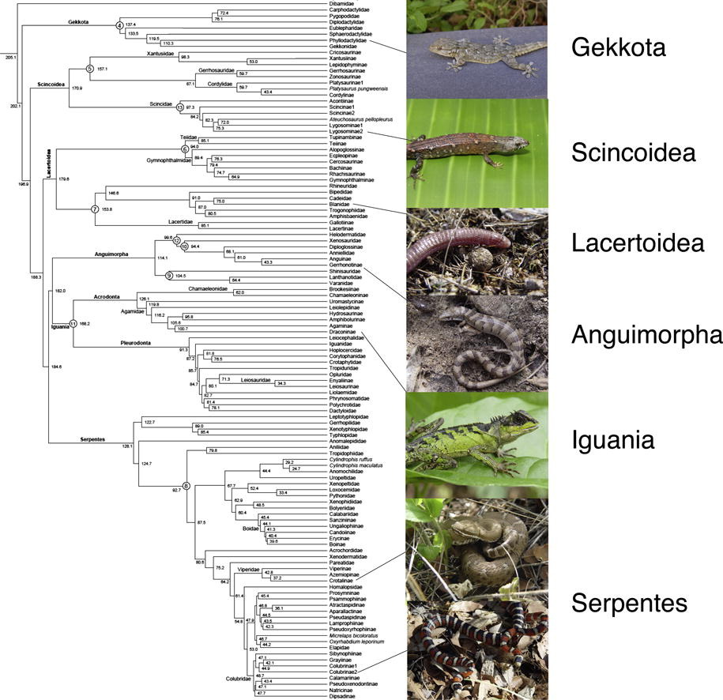
Squamata

Slide 3
Sphenodon
Dibamidae
Gekkota
Scincoidea
Amphisbaenia + Lacertoidea
Iguania (Agamidae, Chameleonidae, Iguanidae)
Anguimorpha
Serpentes
Toxicofera

Slide 4
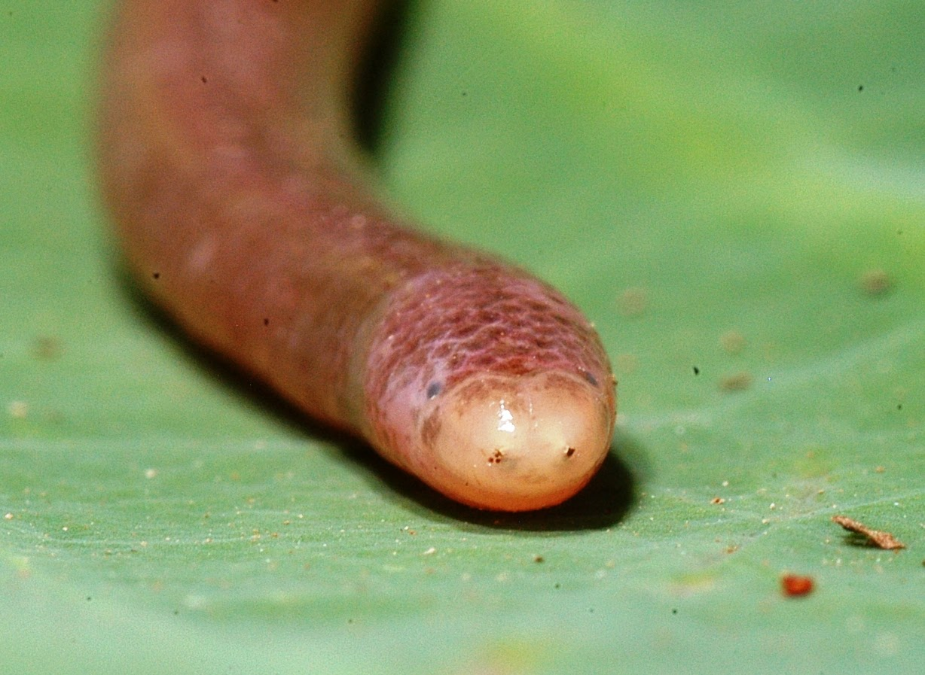
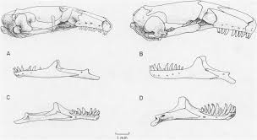
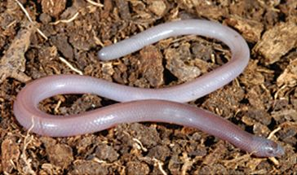
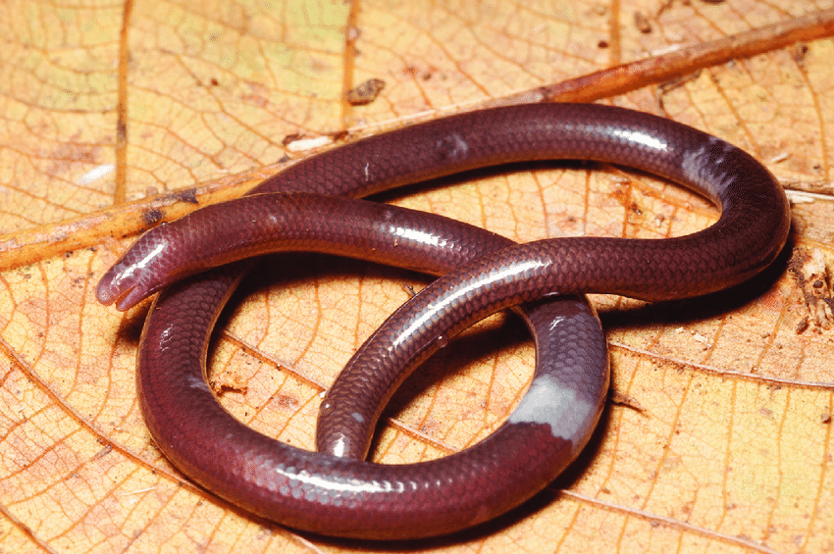
Dibamidae
2 genera, ~20 species

Slide 5
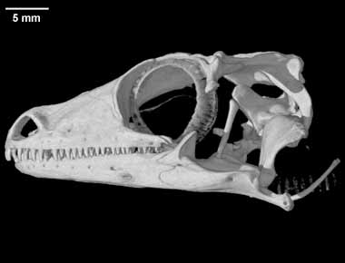
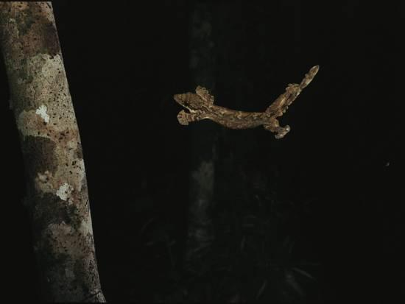
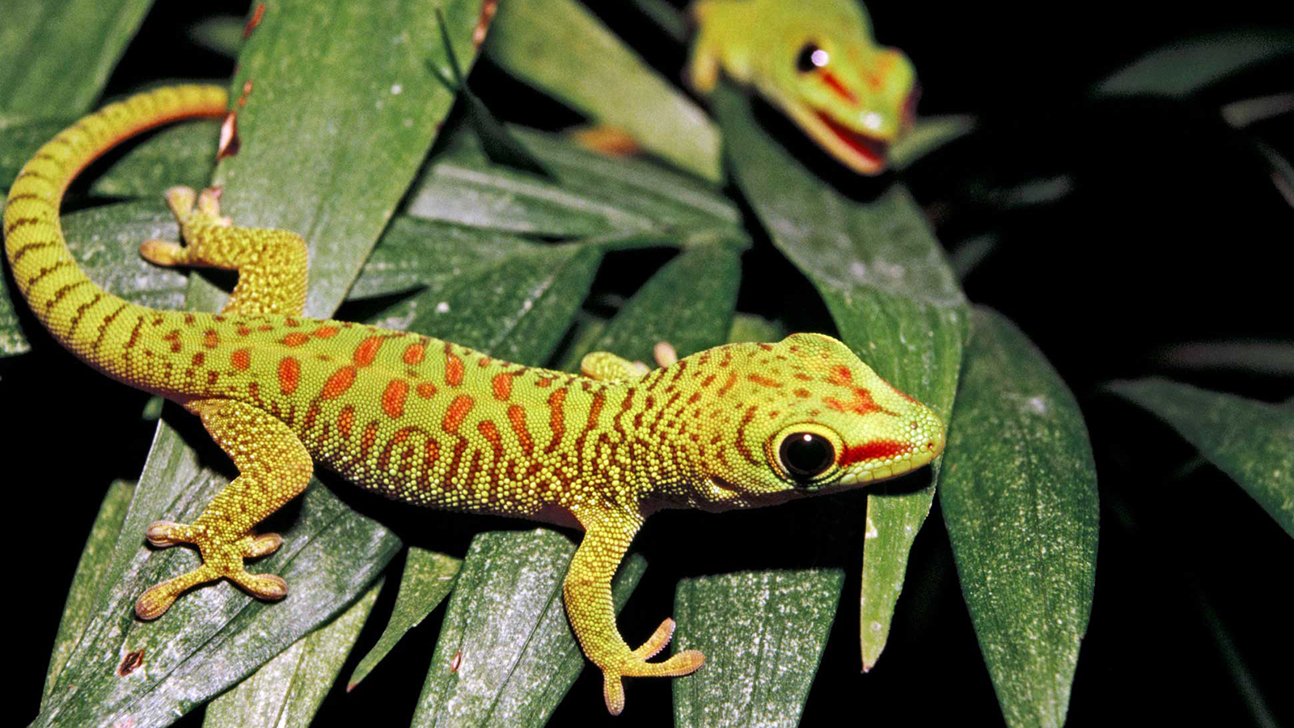
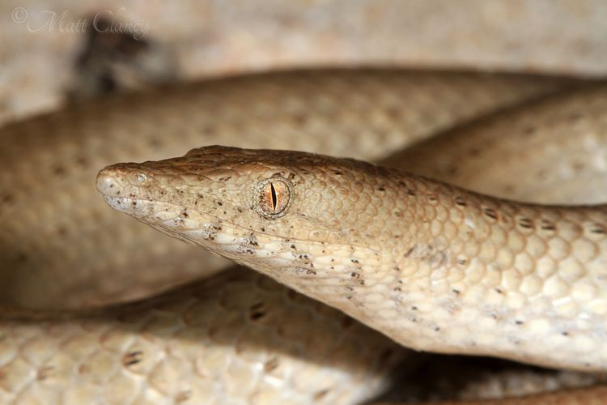
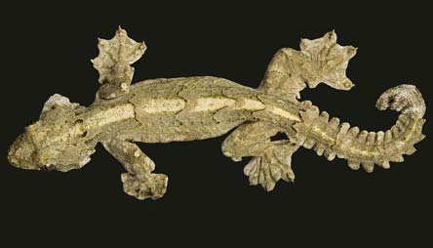
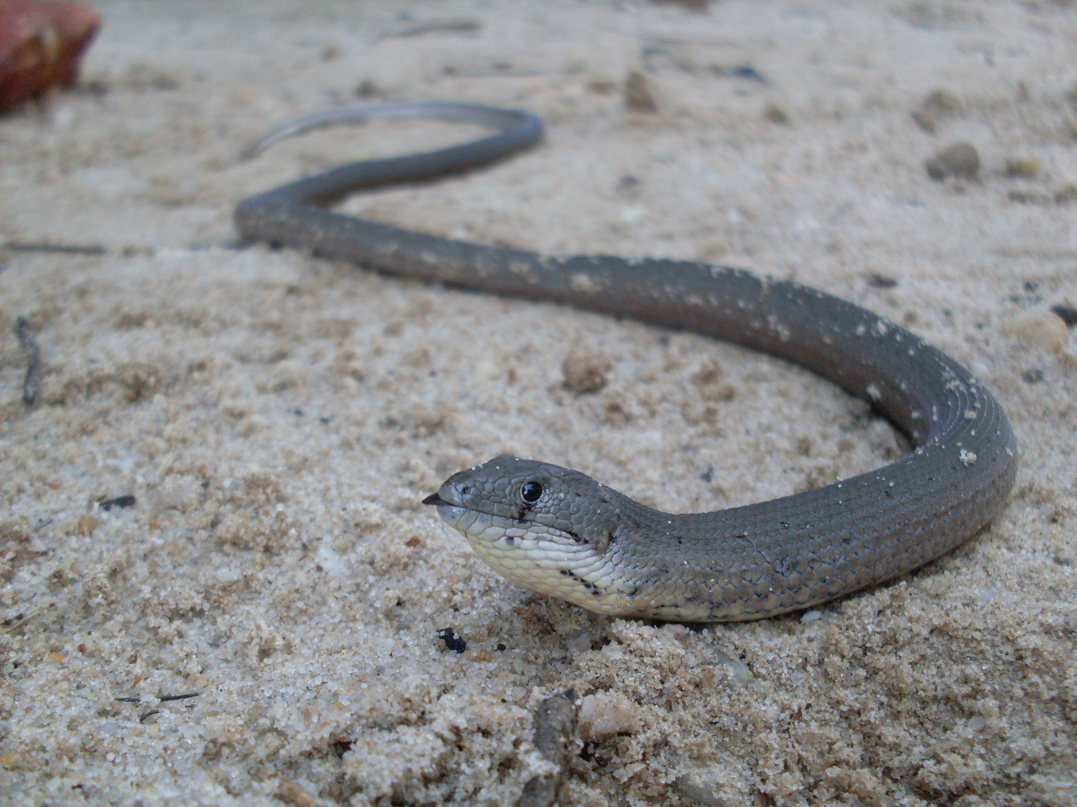
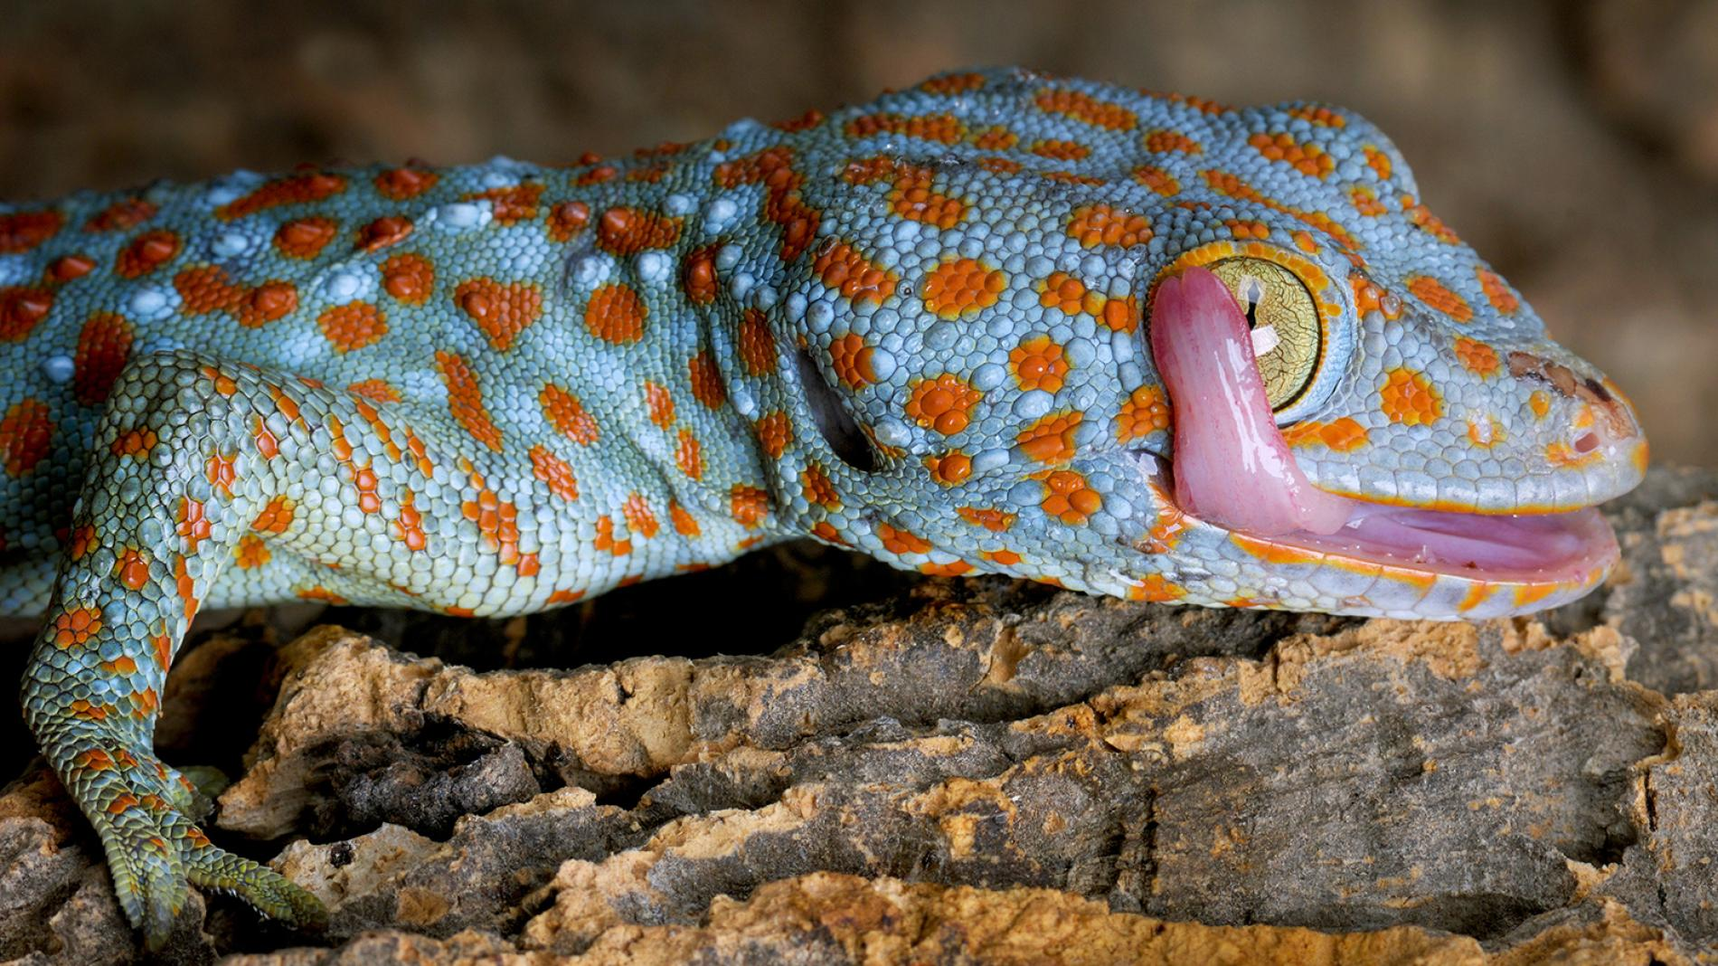
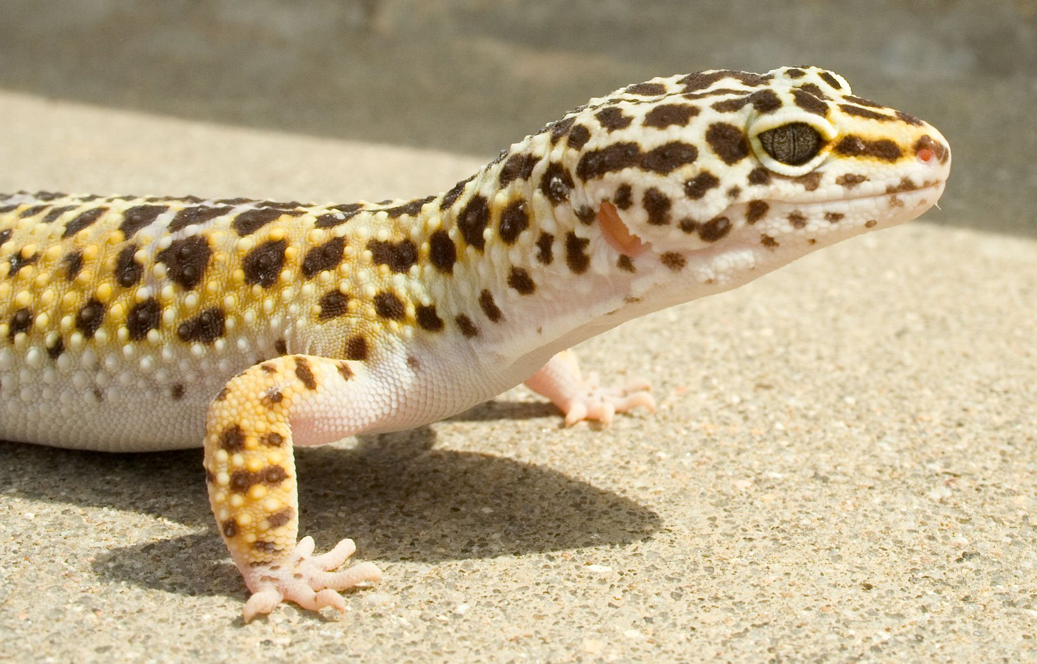
Gekkota (1500 sp)
Notes:
Post-orbital bar incomplete
Upper temporal bar LOST!
Lacrimal LOST

Slide 6
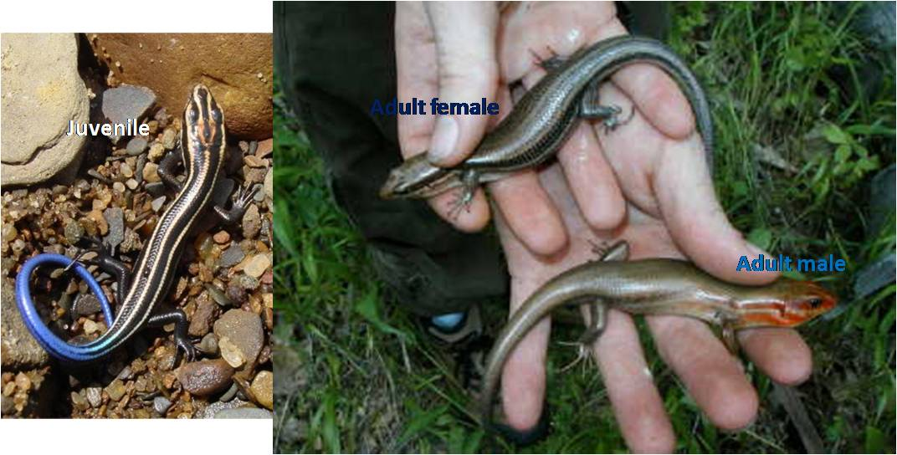
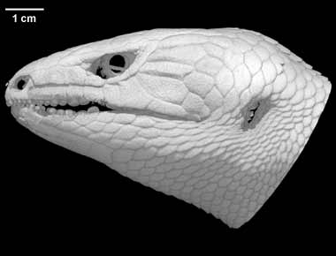
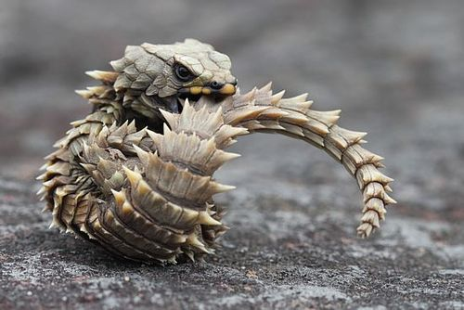
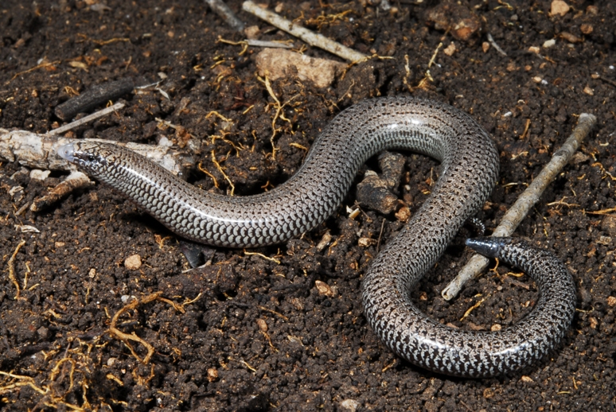
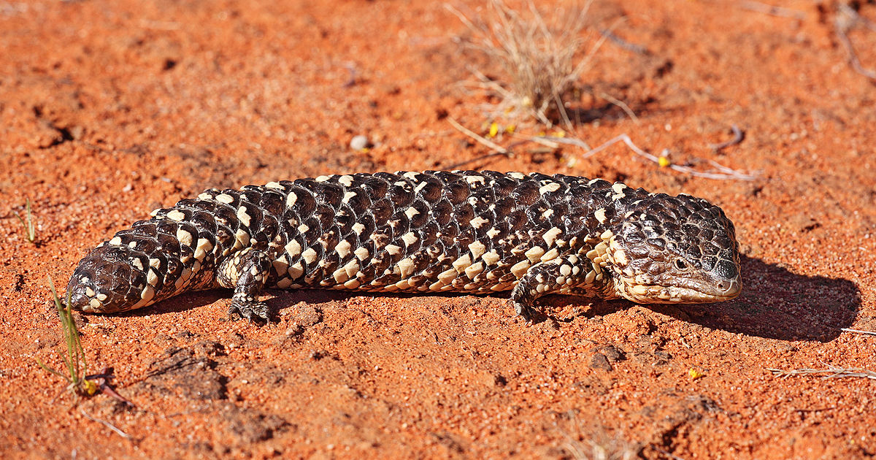
Scincoidea (>2000 sp)

Slide 7
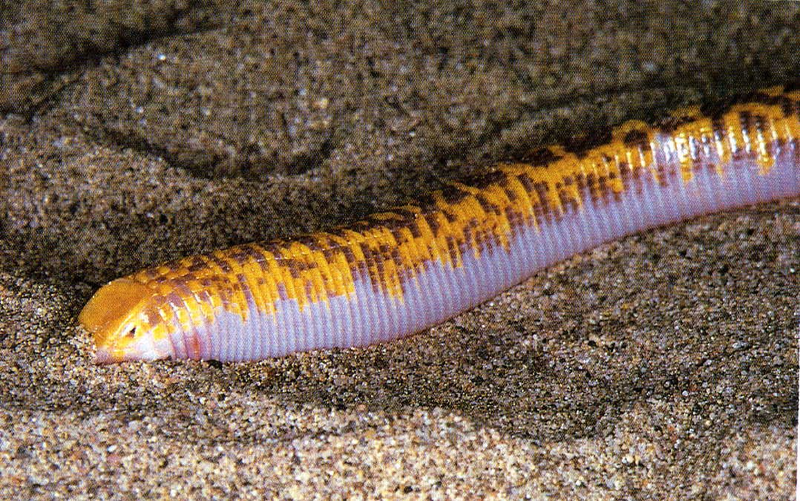
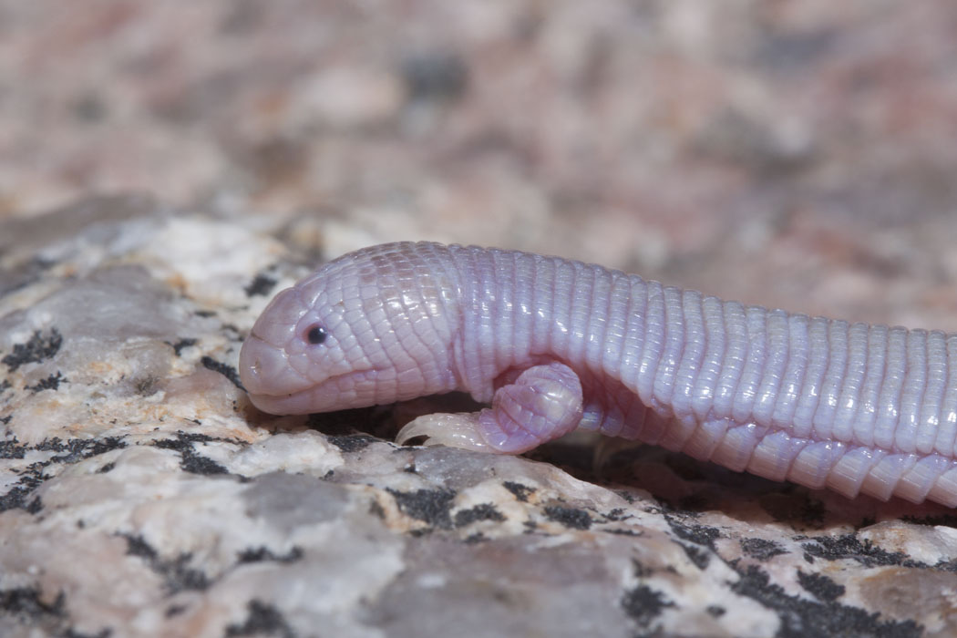
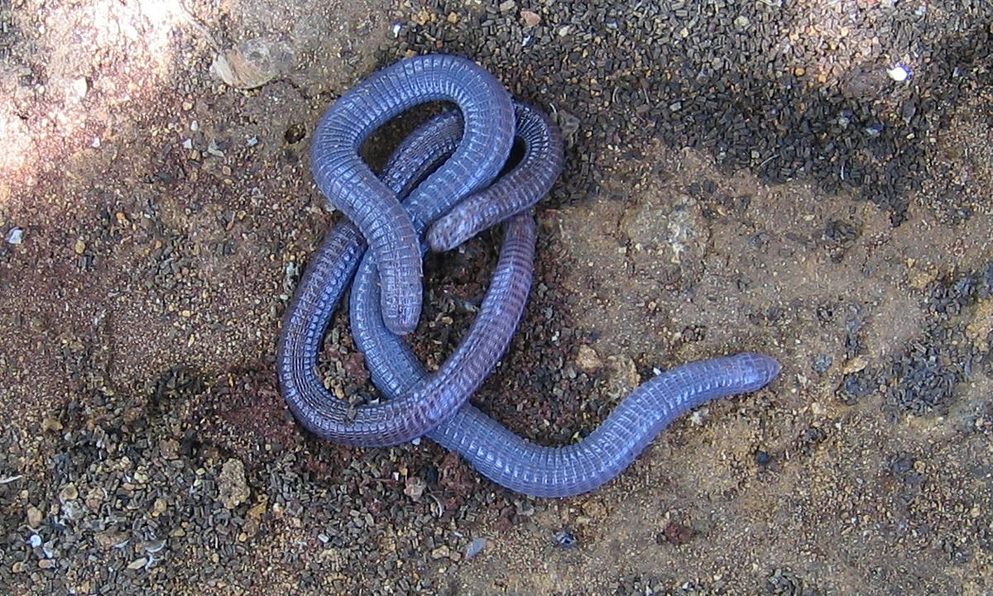
Amphisbaenia (~180 sp)

Slide 8
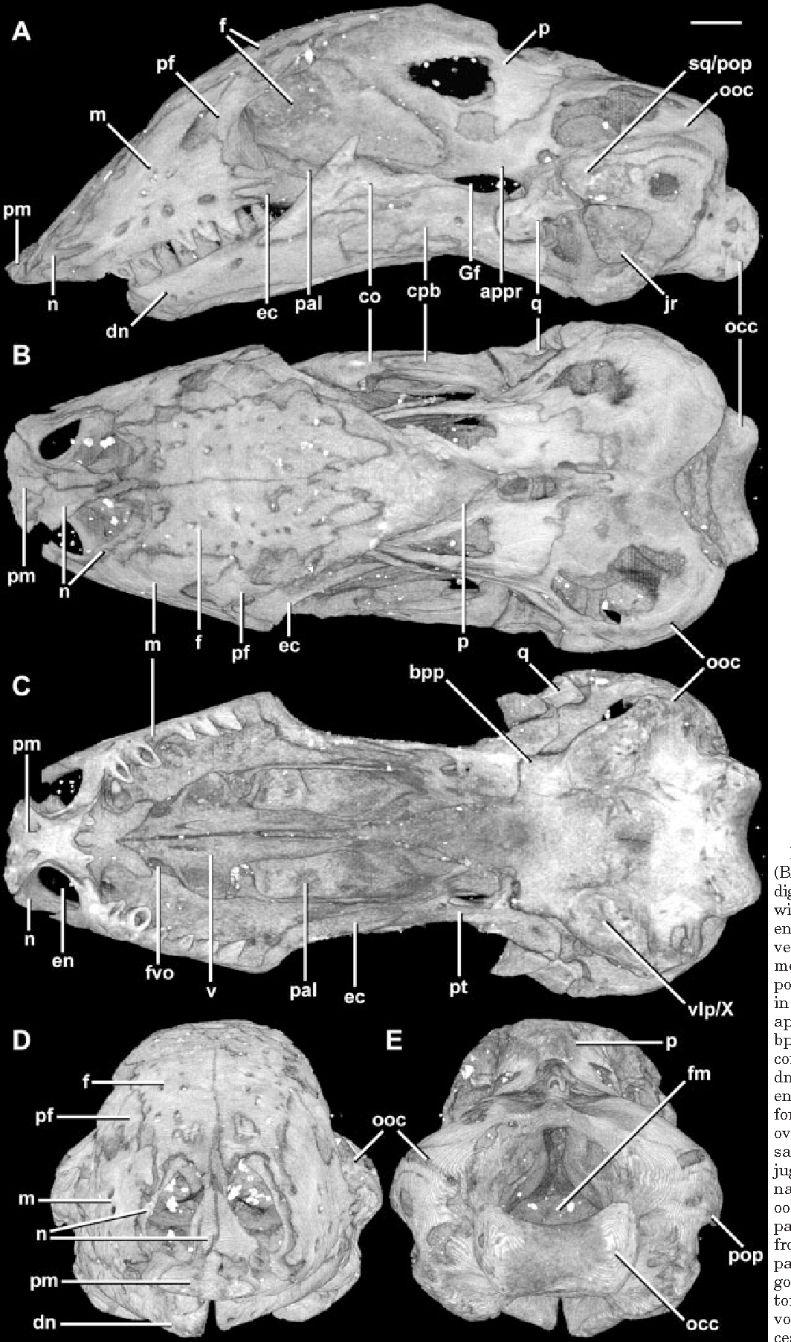
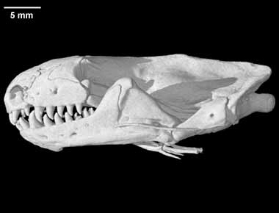
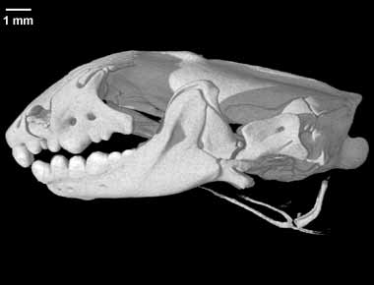
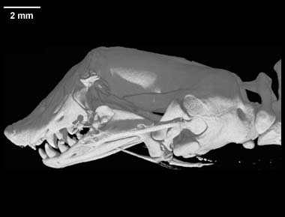
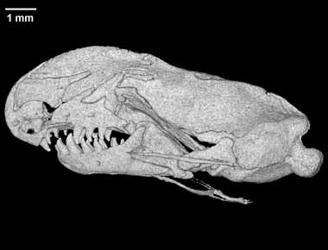
Amphisbaenia

Slide 9
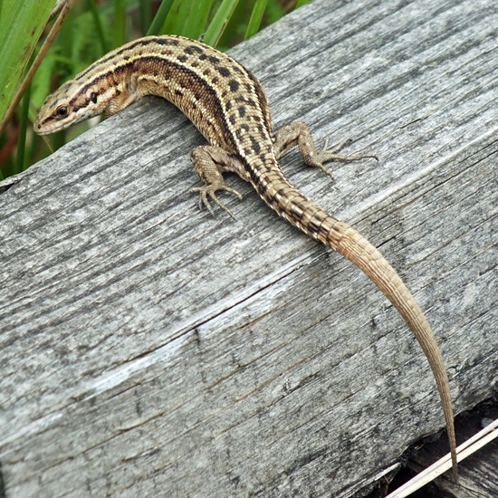
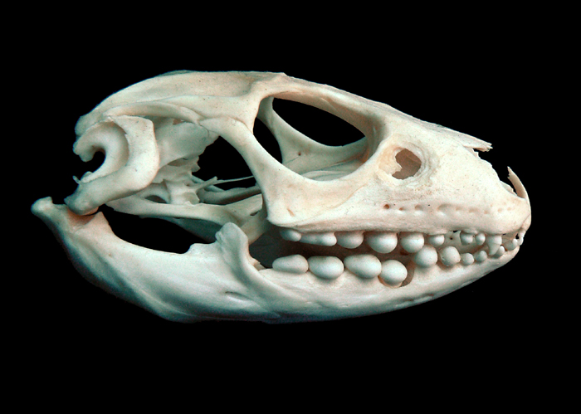
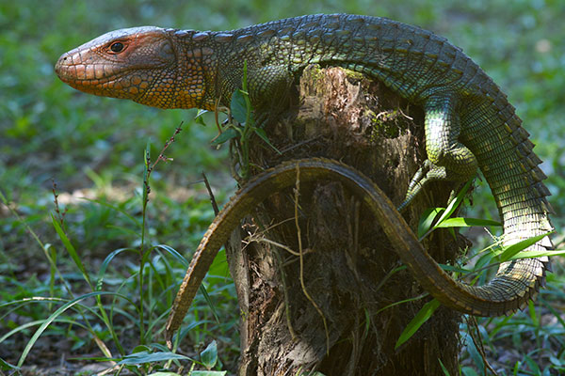
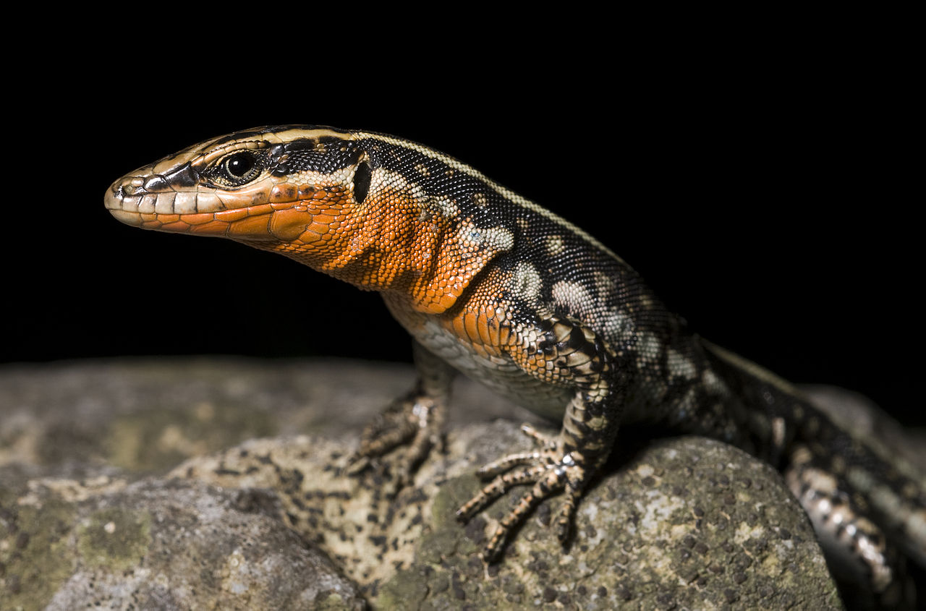
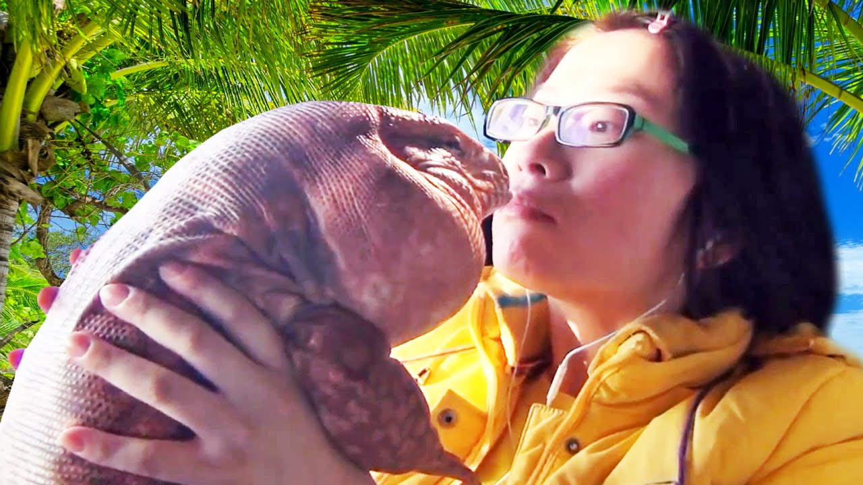
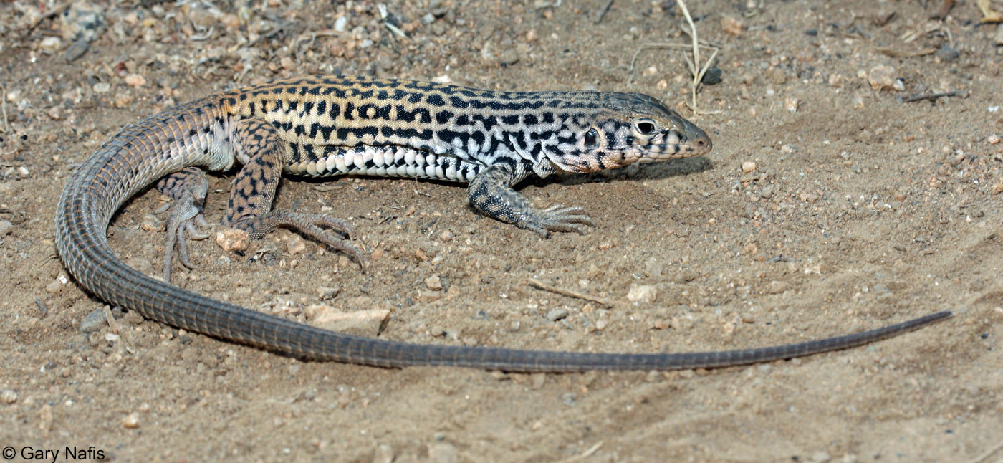
Lacertoidea (~700 sp + Amphis)

Slide 10
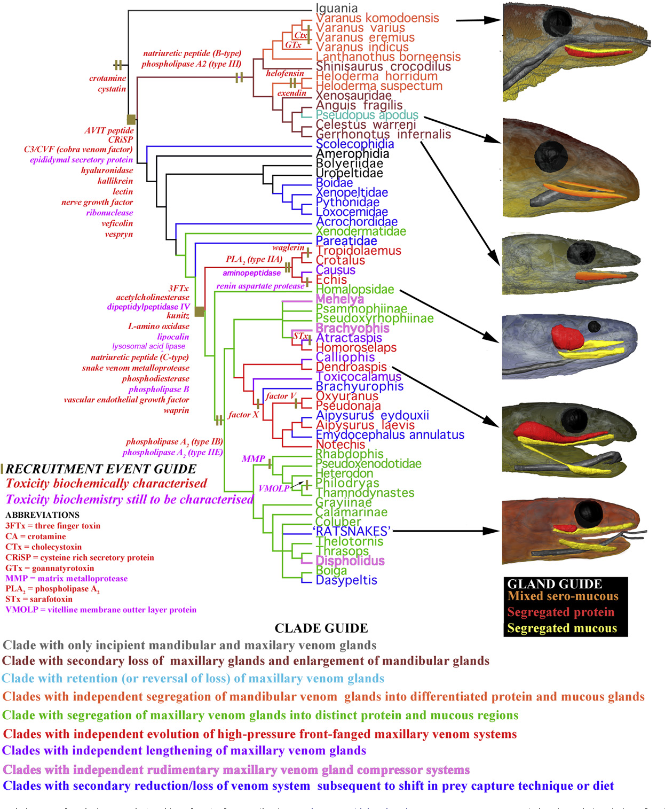
Toxicofera

Slide 11
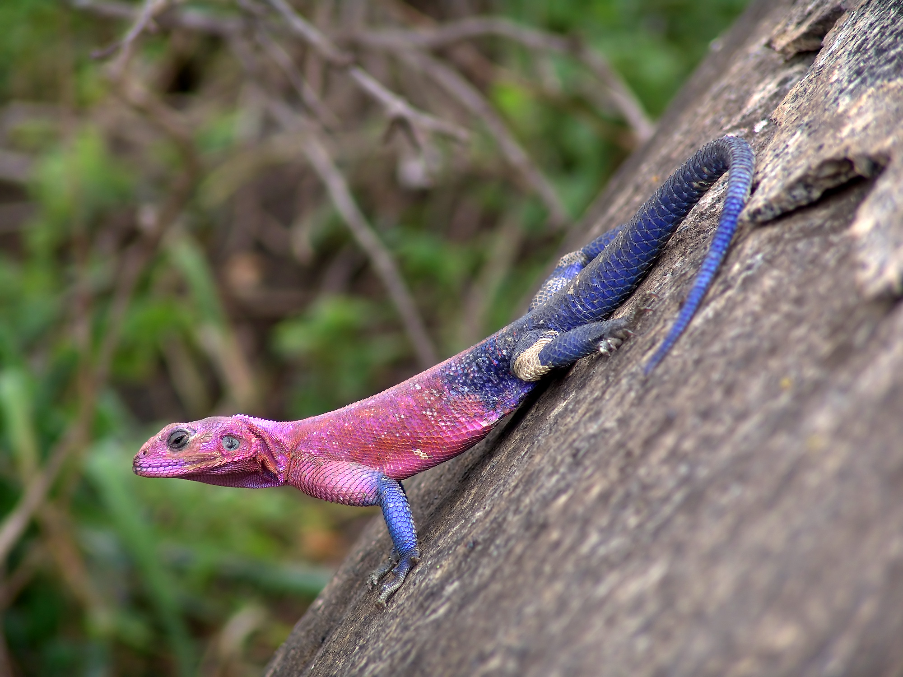
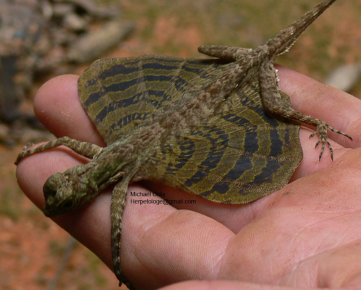
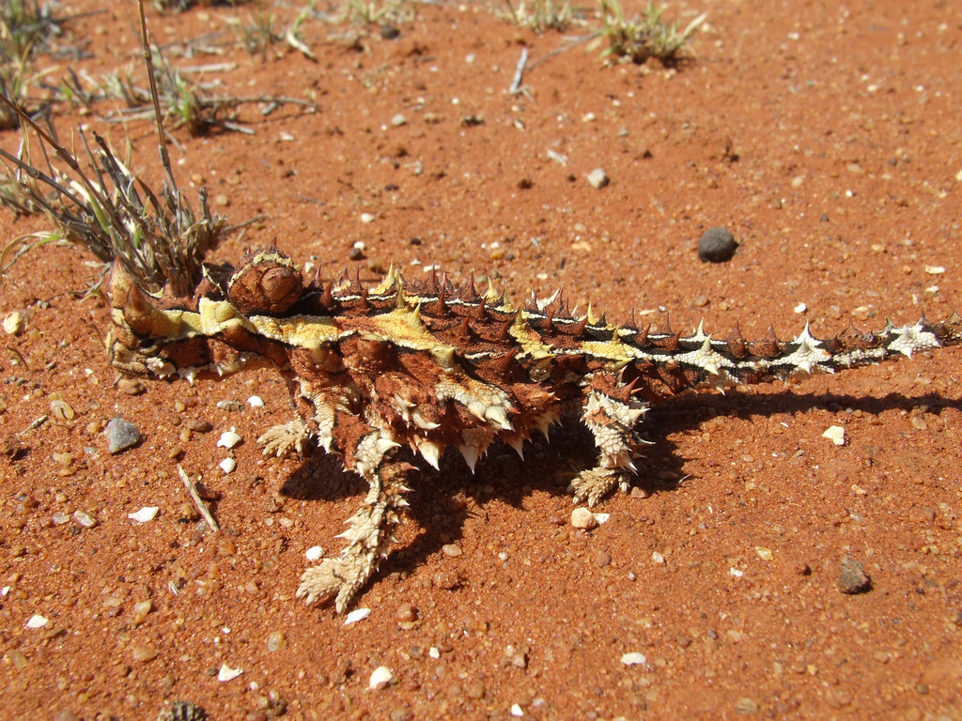
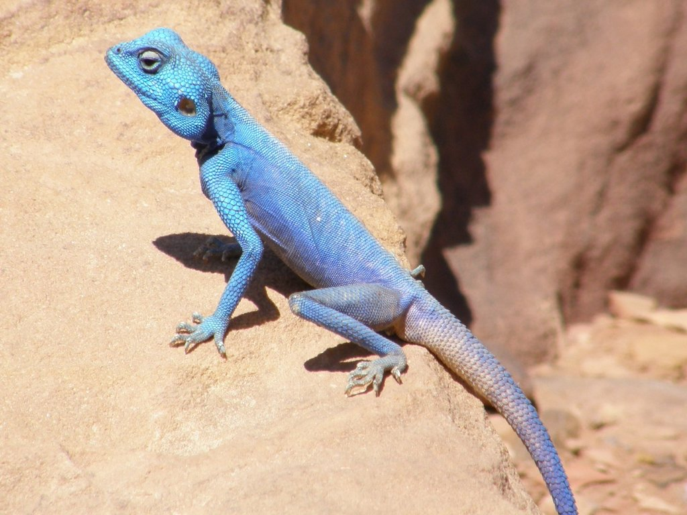
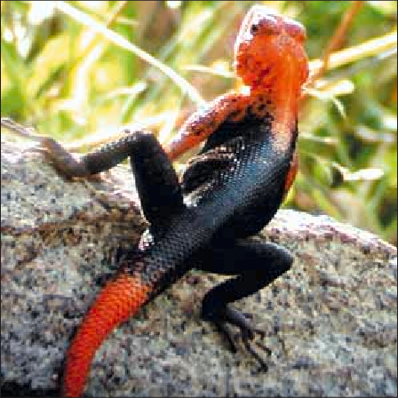
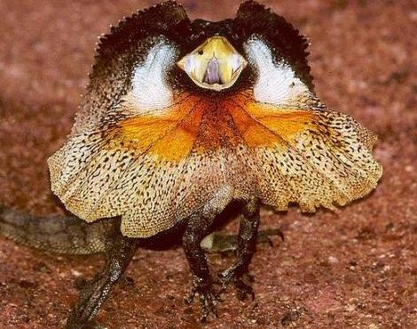
Toxicofera: Iguania: Agamidae (300 species)

Slide 12
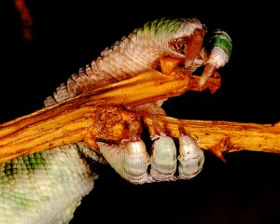
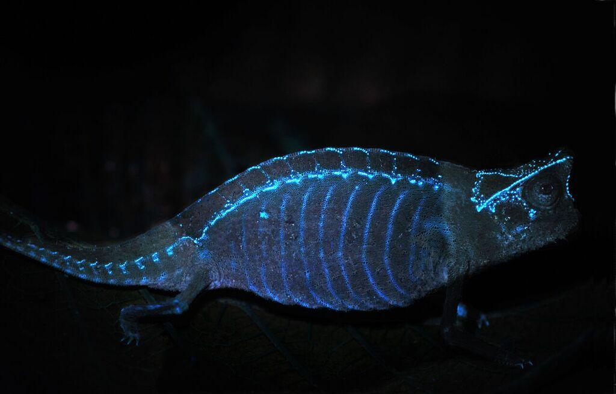
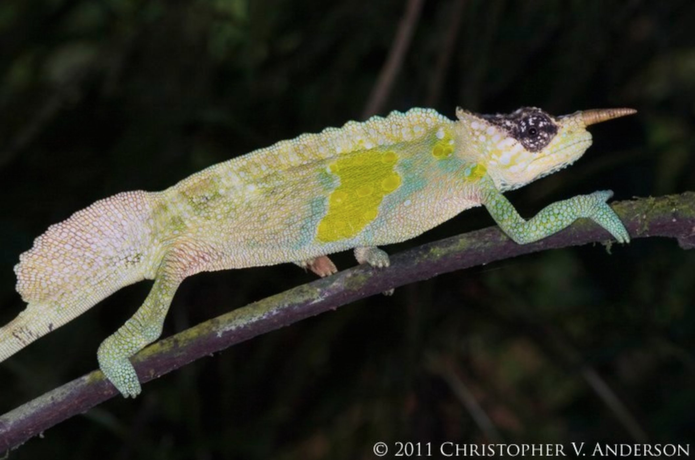
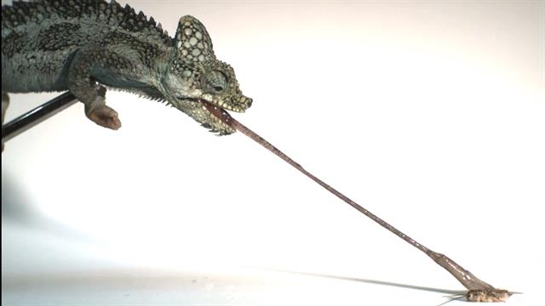
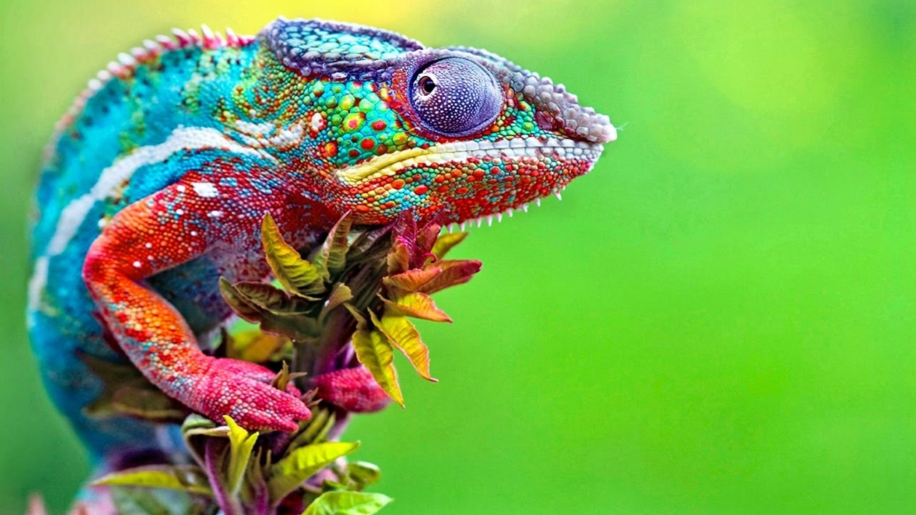
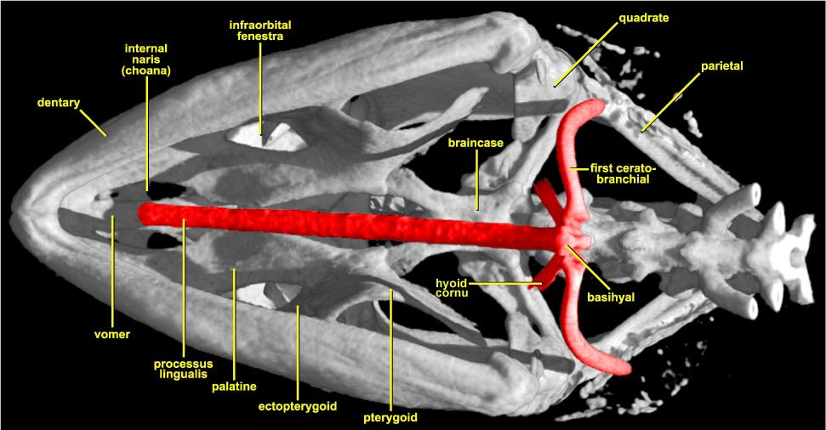
Toxicofera: Iguania: Chameleonidae (~200 species)
Notes:
Chameleon tongue gif

Slide 13
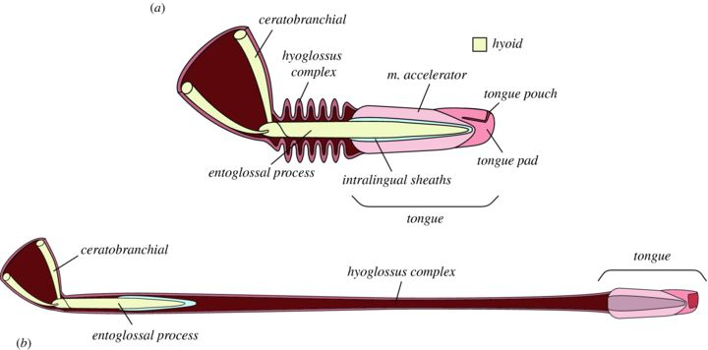
Toxicofera: Iguania: Chameleonidae

Slide 14
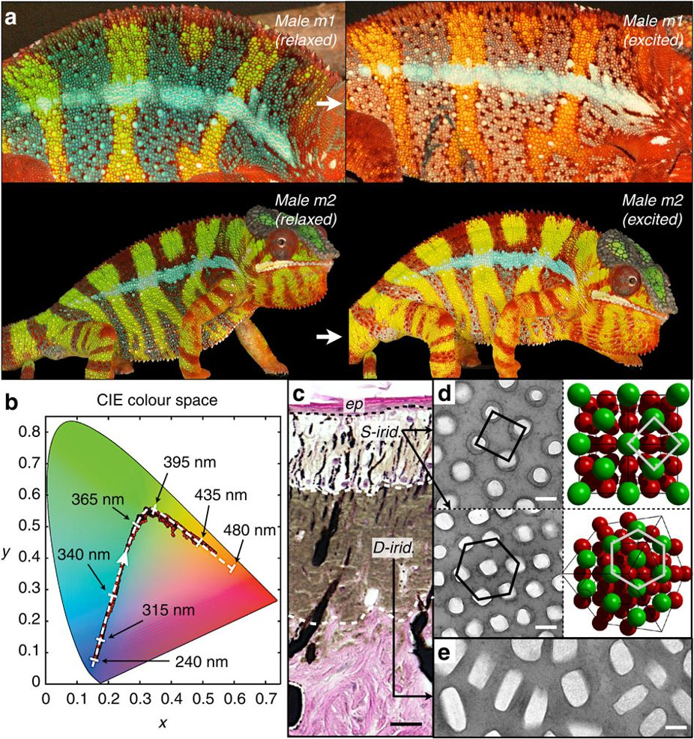
Toxicofera: Iguania: Chameleonidae
Two layers of iridiphores
Guanine crystals embedded
Manipulation produces color

Slide 15
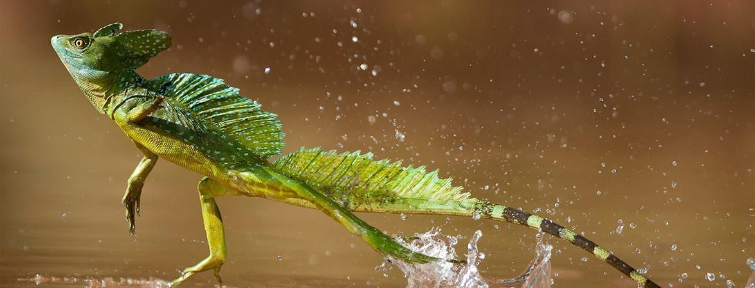
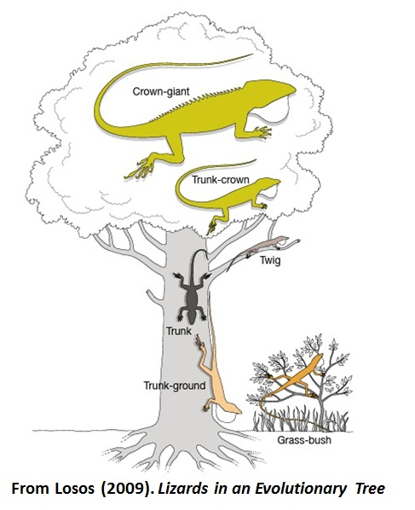
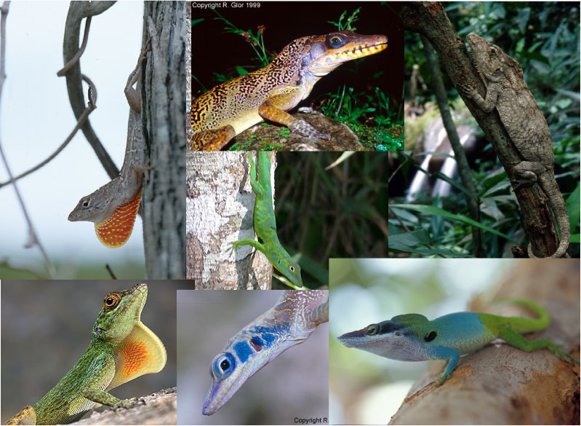



Toxicofera: Iguania: Iguanidae (>500 species)
Notes:
Video f phrynosoma blood squirting

Slide 16





Toxicofera: Anguimorpha
Notes:
Add hyoid

Slide 17
Toxicofera: Serpentes (3000 species)
No external ear
Highly flexible & reduced skull
No eyelids
Pronounced chemosensation via forked tongue
Total loss of forelimbs
Partial-to-total loss of hindlimb

Slide 18


Toxicofera: Serpentes

Slide 19





Toxicofera: Serpentes: Scolecophidia (blind snakes, 40+ sp)

Slide 20






Toxicofera: Serpentes: Alethinophidia Boidae & Pythonidae (50 & 30 sp)
Notes:
PYTHONS: Old World Only, all lay eggs
BOAS: old & New world, have live birth

Slide 21






Toxicofera: Serpentes: Alethinophidia Elapidae (~300 sp)
Notes:
Sea snakes, coral snakes, cobras, & Australian brown snakes & adders

Slide 22

Toxicofera: Serpentes: Alethinophidia Elapidae (~300 sp)
Notes:
Sea snakes, coral snakes, cobras, & Australian brown snakes & adders
Fixed fangs, mostly lay eggs

Slide 23







Toxicofera: Serpentes: Alethinophidia Viperidae
Notes:
Live birth! Mobile fangs! Heat bits in crotalines!

Slide 24







Toxicofera: Serpentes: Alethinophidia Colubridae (~2000 species)

Slide 25



